Slide 1
Lloyd’s Advance Programme Developing our Future Female Leaders
Cohort 11
September 2023 – February 2024
Application deadline 17 July 2023

Slide 2
Advance
Mission Statement
"To better prepare and equip a talent pool of future female leaders for Lloyd's and the wider insurance Industry"
At Lloyd’s our strength lies in the diversity of our people. Their talent means we continue to innovate and provide insurance that supports the economic growth and resilience of communities, cities and countries, enabling human progress.
However, data shows that the increasingly positive gender diversity represented at entry level does not continue into senior levels. Lloyd’s is committed to closing the gender pay gap and, via the Advance Programme, empowering a greater number of women to take up senior roles, improving the gender and broader diversity balance across all levels of the Corporation.

Slide 3
Advance
Programme Overview & Audience
The Advance programme, supports participants to develop the personal attributes, capabilities and networks required to advance their careers as future leaders. It does this through a modular based development programme, with elements targeted specifically at women with future leadership potential.
The audience are at feeder levels to senior leadership (Executive Committee/C-Suit -3) with the potential for leadership promotions and/or lateral moves into new areas. At a minimum manager/senior manager level looking to progress their careers.
Advance creates a community of future female leaders from across the Corporation and the Industry, providing access to tailored development sessions, experts and role models, and on-going networking opportunities, all in support of their growth and success.
6 month programme
15 participants from the Corporation and the Industry
4 x 1 day development session,
Senior Female Role model session & Personality profile report
Sponsoring
Mentoring
Networking

Slide 4
Advance
Programme Benefits - Participants will:
Gain additional personal skills development NOT normally provided in traditional Leadership programmes
Engage with senior leaders from their own organisation through their sponsor and navigate amongst senior leaders with confidence
Learn to manage themselves and their careers effectively and confidently
Gain insights from mentors, sponsors and female programme facilitators
Grow in confidence and develop the capability to apply what they have learned
Expand their network by joining the Advance Alumni
Have access to post-programme development opportunities as they are made available

Slide 5
All Times are UK
Virtual
Advance
In Person (London)
These events include Managers, Sponsors & Mentors
Programme Timeline
Pre-programme self-assessment
1 | 14th Sep 2023, 13:00-15:00 LAUNCH EVENT for Delegates | 5 | 9th Nov 2023, Full day MODULE 1 Unlocking Self-Limiting Beliefs | 9 | 7th Dec 2023, Full day MODULE 3 Navigating & Influencing Stakeholders
2 | 14th Sep 2023, 15:30-17:00 LAUNCH EVENT for Line Managers, Sponsors & Mentors | 6 | 21st Nov 2023, 09.00-14.00 MODULE 2 Creating a Sense of Personal Brand & Profile | 10 | 17th Jan 2024, Full day MODULE 4 Negotiation for Own Success
3 | 21st Sep 2023, 09:30-11:00 Career insights from a Senior Female Leader | 7 | 23rd Nov 2023, 09:00-13:00 MID-POINT REVIEW for Managers, Sponsors & Mentors 60 min per group | 11 | 30/31 Jan 2024, times TBC Virtual Action Learning 4 x 2hr sessions – 4/5 people per group
4 | Sept/Oct 2023, times TBC DiSC PSYCHOMETRIC & 1:1 Debrief | 8 | Nov/Dec 2023, times TBC 1:1 CAREER COACHING sessions | 12 | 8th Feb 2024, 8.30-11.00 Closing Event for All Learning showcase
Post-programme alumni opportunities
Blended Learning Platform – Curated learning content, learning journal, pre & post module activities and community discussion space.
Regular Meetings – between delegate & Managers, Mentors & Sponsors

Slide 6
Advance
Core Module Spotlight
Unlocking Self-Limiting Beliefs
This workshop provides participants with the tools and techniques required to identify the roots of their limiting beliefs. They will use a range of practical tools to work through real life examples, enabling them to face future barriers with resilience and a capability to tackle them with confidence.
Creating sense of personal brand and profile
During this highly experiential workshop participants explore what their personal brand is from the perspective of Body, Emotion and Language. There is individual feedback provided for every participant.
Influencing and Navigating Stakeholders
This workshop enables participants to map their stakeholders, identifying where new relationships are needed. It will take a behind the scenes look at influence, and equip them with the skills they need to master to succeed.
Negotiating for Your Own Success
Looking at the core aspects of negotiation this workshop will share a practical and highly effective process, together with the skills needed at each phase, to help participants prepare and execute those critical career negotiations.

Slide 7
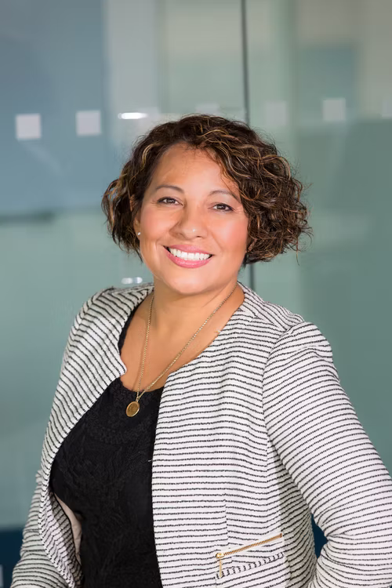
Advance
Roles and commitments
Participant
To attend all of the programme development events and to work closely with your Line Manager, Sponsor and Mentor to develop your capability, grow your network and career potential as a future leader.
Own your learning, choose specific actions to apply what you learn.
Contribute your experiences, be open to learning from other cohort members.
Schedule meetings and own the relationship with your mentor and sponsor.
Engage with your mentor to learn from their experiences.
Engage with your sponsor to broaden your access, connections, opportunities to attend events, and engage with a wider network of leaders.
Partner with your line manager to apply your learning and stretch yourself to prepare for more senior level opportunities.
Own your career path. Take advice, gain support as you have these experiences.

Slide 8
Advance
Roles and commitments to participant
Sponsor
Mentor
Manager
Attend the Launch, Mid-point and Closing Events
Have regular 1:1 meetings
Attend the Launch, Mid-point and Closing Events
Have regular 1:1 meetings
Attend the Launch, Mid-point and Closing Events
Have regular 1:1 meetings specifically related to the programme
Gain an understanding of their strengths and career aspirations
Advocate for and champion your participant for career progression
Share your leadership network connections to increase visibility
Open doors and create opportunity to attend a wider variety of events
Post programme, continue the relationship for at least 6 months
Role model and inspire strong leadership values
Act as sounding board for career thinking and evaluating opportunities
Share relevant industry experience and lessons learned generously
Guide, motivate & build confidence
Post programme, continue the relationship for at least 6 months
Help make time and space to fully engage with the learning
Check-in regularly on learning focus and support required
Encourage and challenge whenever appropriate
Provide immediate feedback on the progress you see
Post programme, agree a plan for continuous growth and application of learning

Slide 9
Advance
Previous Cohort Quotes & Highlights:
“The Advance course was personal and relevant and has given me the confidence in my intentions for my career development.”
Guest speakers have included:
Jo Scott
Chief Marketing & Comms Officer
Lloyd’s
Emma Woolley Chief Executive Officer
Lancashire Syndicates Limited
Sheila Cameron
Chief Executive Officer
Lloyd’s Market Association
Kim Swan
Chief Risk Officer (Asia)
Liberty Specialty Markets
“Following the course, I feel inspired to build my capabilities and confidence. I have met incredible women who have supported each other through open discussions and have learnt how to recognise what gives us energy and adds meaning to our lives.”
“To think outside of our comfort zones, framework of questioning, creating brands and confidence in speaking up.”
For females on Advance cohort 5, in the 2 years since completing the programme, 100% of the responders celebrated an improved role, promotion, secondment or role stretch.

Slide 10
Advance Application Criteria
Nomination Process The programme requires active support from a candidate’s line manager. The nomination is to be completed by the line manager, with the support from their Talent Development or HR representative. Individual organisations will be responsible for identifying the candidate and engaging their sponsors – who should be at an executive level / senior leadership level, or at least 2 levels above the candidate. Consideration will be given to the range of organisations taking part in the programme, to participants identified as key talent and the points highlighted in the endorsement from the line manager.
Application deadline is 17 July 2023 . Nominated candidates will be advised of the outcome by Friday 28th July. Where the programme has reached capacity, it may be possible to defer a candidate to the next cohort. Candidates This programme is aimed female talent. Nominees should consistently receive high performance ratings and would be considered suitable candidates for future leadership roles. They will show a commitment to learning and progression and have the ability to take on stretch assignments.
All applications will be considered on merit and sponsorship with agreement from your HR Business Partner.
Candidates must block out all dates (on slide 5) in their diaries when applying. Attendance at all sessions is necessary to gain the full benefit form the programme.

Slide 11
Advance
Programme Costs & Questions
Costs
The participant cost of this programme is £3,500 +VAT which includes
Launch & Closing Events (in-person)
Mid-point events for Managers, Mentors & Sponsors
Career insights from Senior Female Event / Q&A Session (in-person )
Personalised psychometrics
1:1 DiSC Debrief & Career Coaching (virtual)
4 x Core modules with expert facilitators (in-person)
Action Learning Session (virtual)
Questions
If you have any questions, please contact:
Aaron Boyle, Lloyd’s Leadership and Learning Curriculum Manager
Aaron.Boyle@Lloyds.com
Guest speakers have included:
Sara Gomez
Chief People Officer
Lloyd’s
Gina Butterworth Director of Underwriting
Nephila Syndicate
Jennifer Hummerston
Director of Underwriting
Polo
For Advance delegates in cohort 8, 100% of this latest cohort agreed that they gained knowledge that can be applied to their career.

Slide 12
Advance
Success Measures
Measured at 12, 24 and 36 months after the conclusion of the programme. It will consist of feedback on several levels, including:
Progress using effective tools and techniques to progress career
More effective career planning with clear and specific actions
Engaging with leaders more confidently and building networks
Greater access to a broader range of senior leaders
Growing professional network being used to develop career
Maintaining senior sponsorship support to gain wider access, opportunities
Securing a variety of career growth and advancement opportunities
Securing formal recognition for achievements

